Slide 1


GAUSS DIVERGENCE THEOREM
TEAM MEMBERS:
PRANAV SINGH (71)
SRISHTI SINGH (72)
MIHIR SONI (73)
OM SUTARIA(74)
VEDANT TADLA(75)

Slide 2
LEARNING OBJECTIVES:
Explain the meaning of gauss divergence theorem.
Applications of gauss divergence theorem.

Slide 3
OVERVIEW:
PREREQUISITES
GAUSS DIVERGENCE THEOREM
APPLICATIONS OF GAUSS DIVERGENCE THEOREM
EXAMPLE
BIBLIOGRAPHY

Slide 4

PREREQUISITES:
DIVERGENCE:
The divergence of a continuously differentiable vector point function F is denoted by div F & is defined by the equation,
div F = $∇$. F = $I⋅\frac{∂F}{∂x}+J⋅\frac{∂F}{∂y}+K⋅\frac{∂F}{∂z}$
If F = f I +$φ$ J + $Ψ$ K then
div F = $∇$. F
= $\left(I⋅\frac{∂}{∂x}+J⋅\frac{∂}{∂y}+K⋅\frac{∂}{∂z}\right)$ . (f I +$φ$ J + $Ψ$ K )
= $\frac{∂f}{∂x}+\frac{∂φ}{∂y}+\frac{∂Ψ}{∂z}$

Slide 5
GAUSS THEOREM:
In vector calculus, the divergence theorem, also known as Gauss's theorem or Ostrogradsky's theorem,[1] is a theorem which relates the flux of a vector field through a closed surface to the divergence of the field in the volume enclosed.

Slide 9
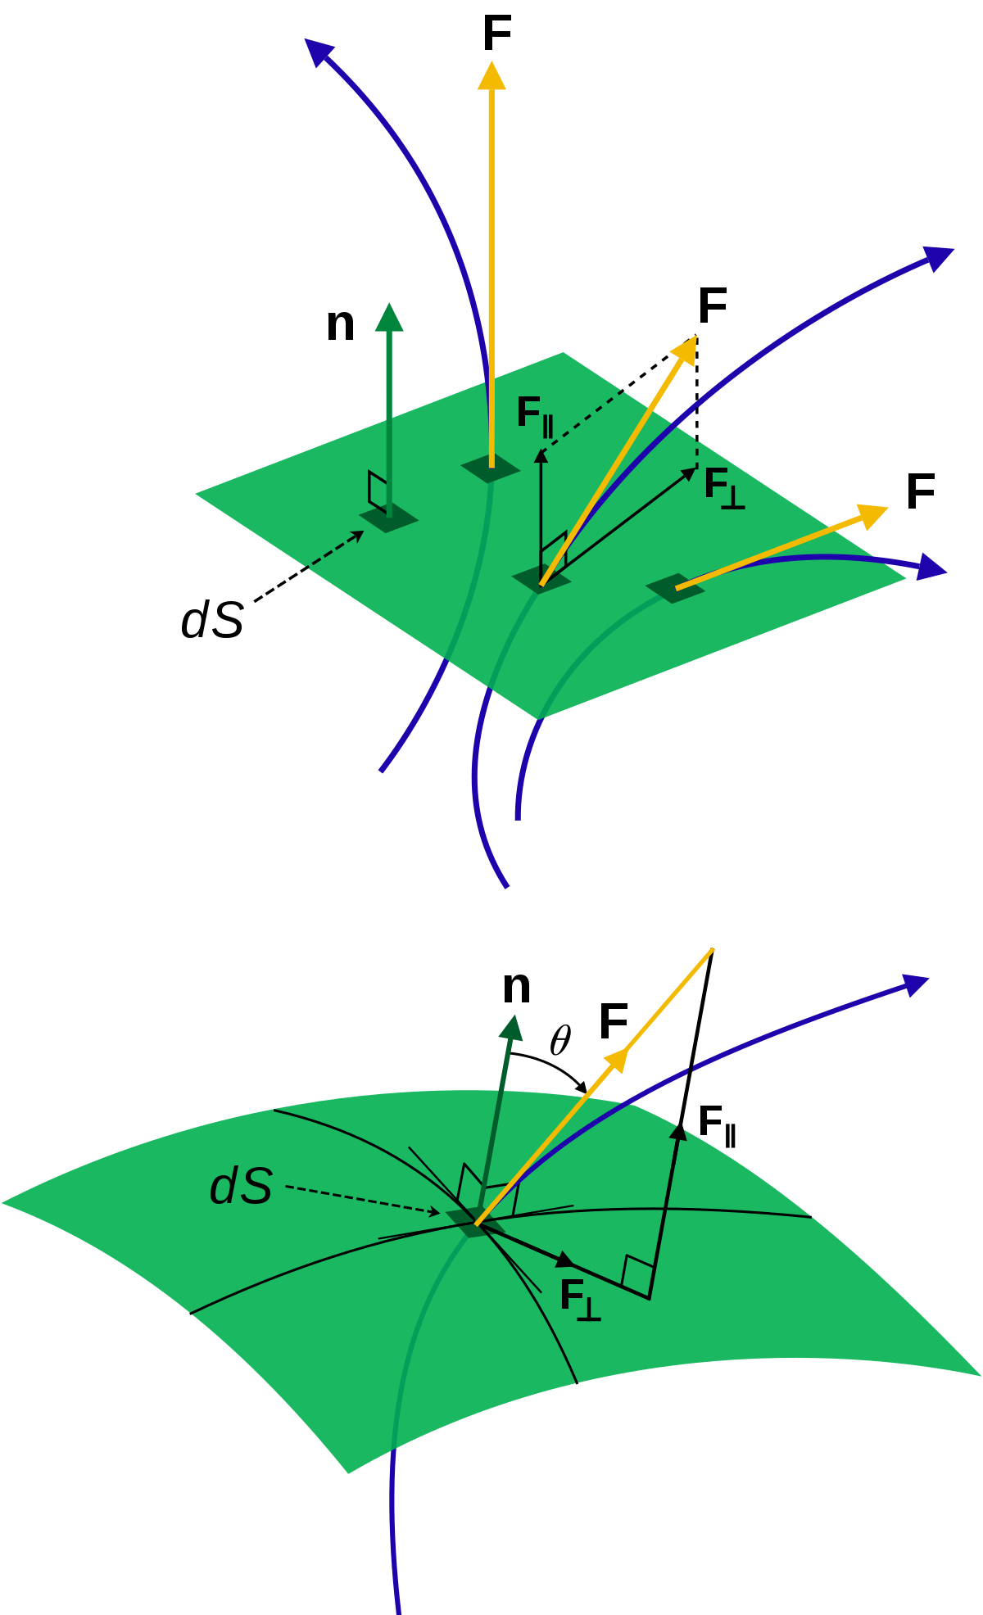
Flux is a vector quantity, describing the magnitude and direction of the flow of a substance or property. In vector calculus flux is a scalar quantity, defined as the surface integral of the perpendicular component of a vector field over a surface.

Slide 12
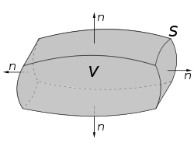

Mathematical Statement
Suppose V is a subset of R^{n} (in the case of n = 3, V represents a volume in three-dimensional space) which is compact and has a piecewise smooth boundary S (also indicated with ). If F is a continuously differentiable vector field defined on a neighborhood of V, then

Slide 13
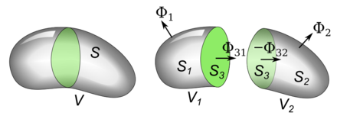

Mathematical Derivation
See the diagram. A closed, bounded volume V is divided into two volumes V1 and V2 by a surface S3 (green). The flux Φ(Vi) out of each component region Vi is equal to the sum of the flux through its two faces, so the sum of the flux out of the two parts is
The "outward" direction of the normal vector is opposite for each volume, so the flux out of one through S3 is equal to the negative of the flux out of the other

Slide 14

so these two fluxes cancel in the sum. Therefore
Since the union of surfaces S1 and S2 is S

Slide 15


The flux Φ out of each volume is the surface integral of the vector field F(x) over the surface
from the definition of divergence, the
ratio of flux to volume, , the part in parentheses below, does not in general vanish but approaches the divergence div F as the volume approaches zero.

Slide 16

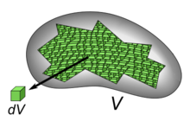



As long as the vector field F(x) has continuous derivatives, the sum above holds even in the limit when the volume is divided into infinitely small increments
As approaches zero volume, it becomes the infinitesimal dV, the part in parentheses becomes the divergence, and the sum becomes a volume integral over V
As the volume is subdivided into smaller parts, the ratio of the flux (V_{i} ) out of each volume to the volume
approaches div F

Slide 17
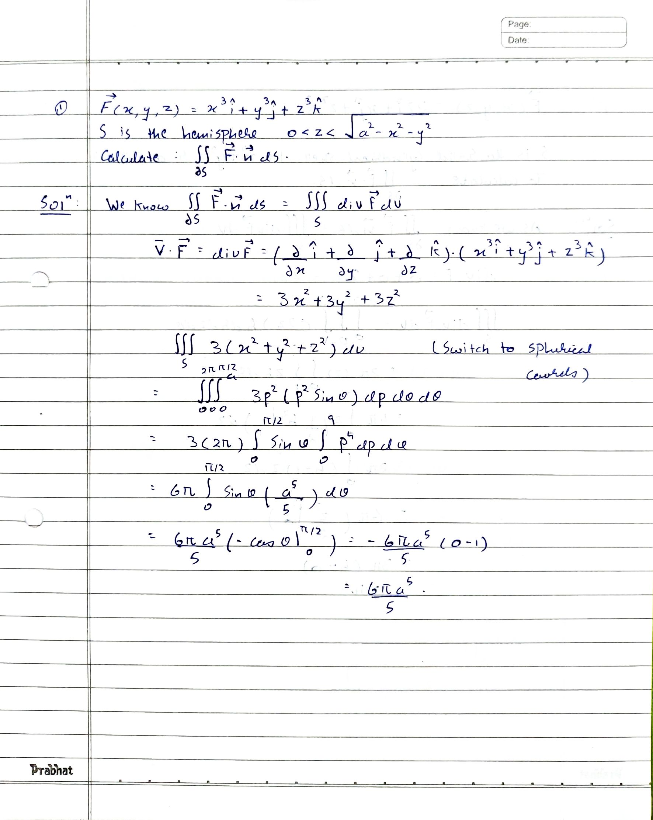
Examples
1)

Slide 18
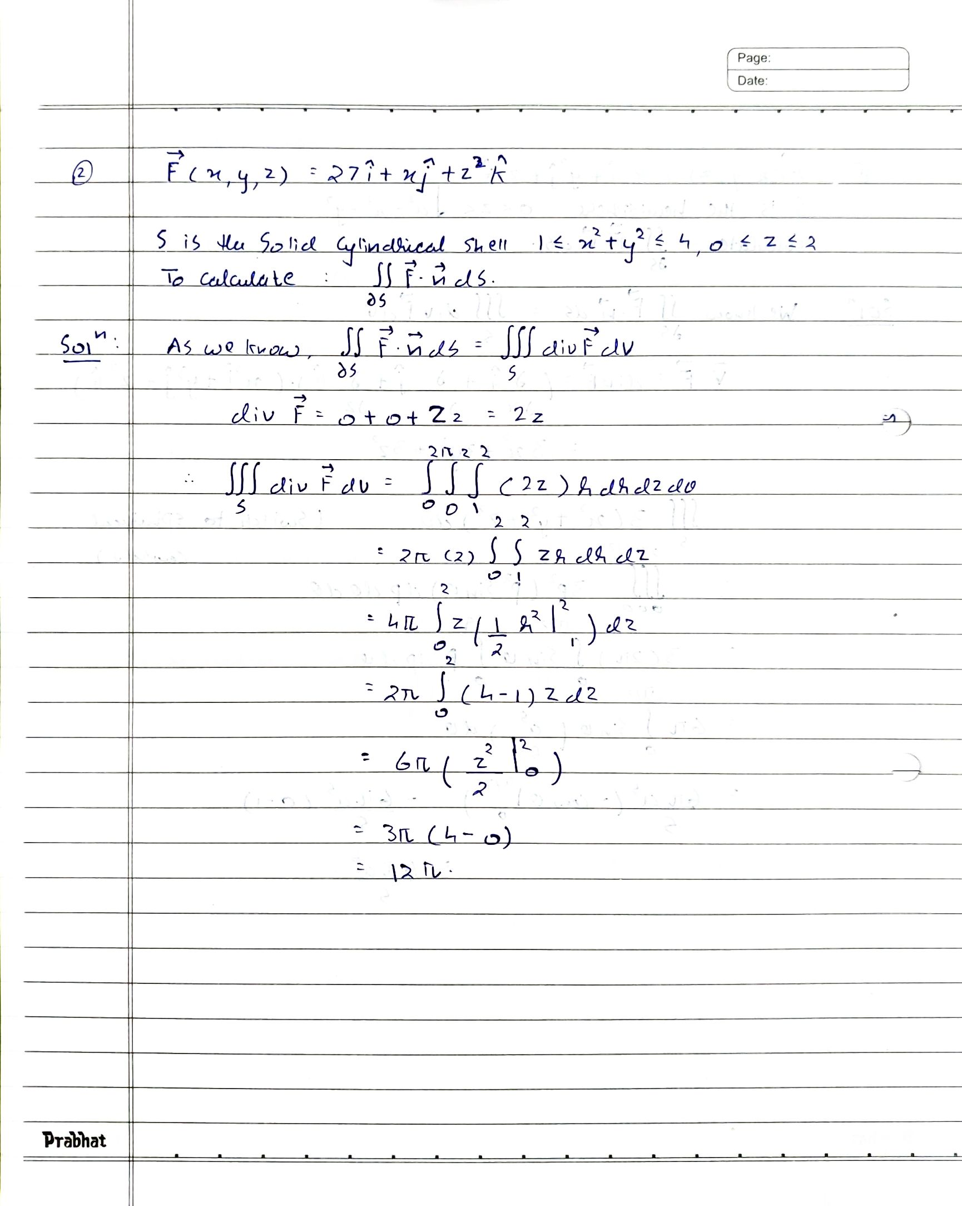
2)

Slide 19
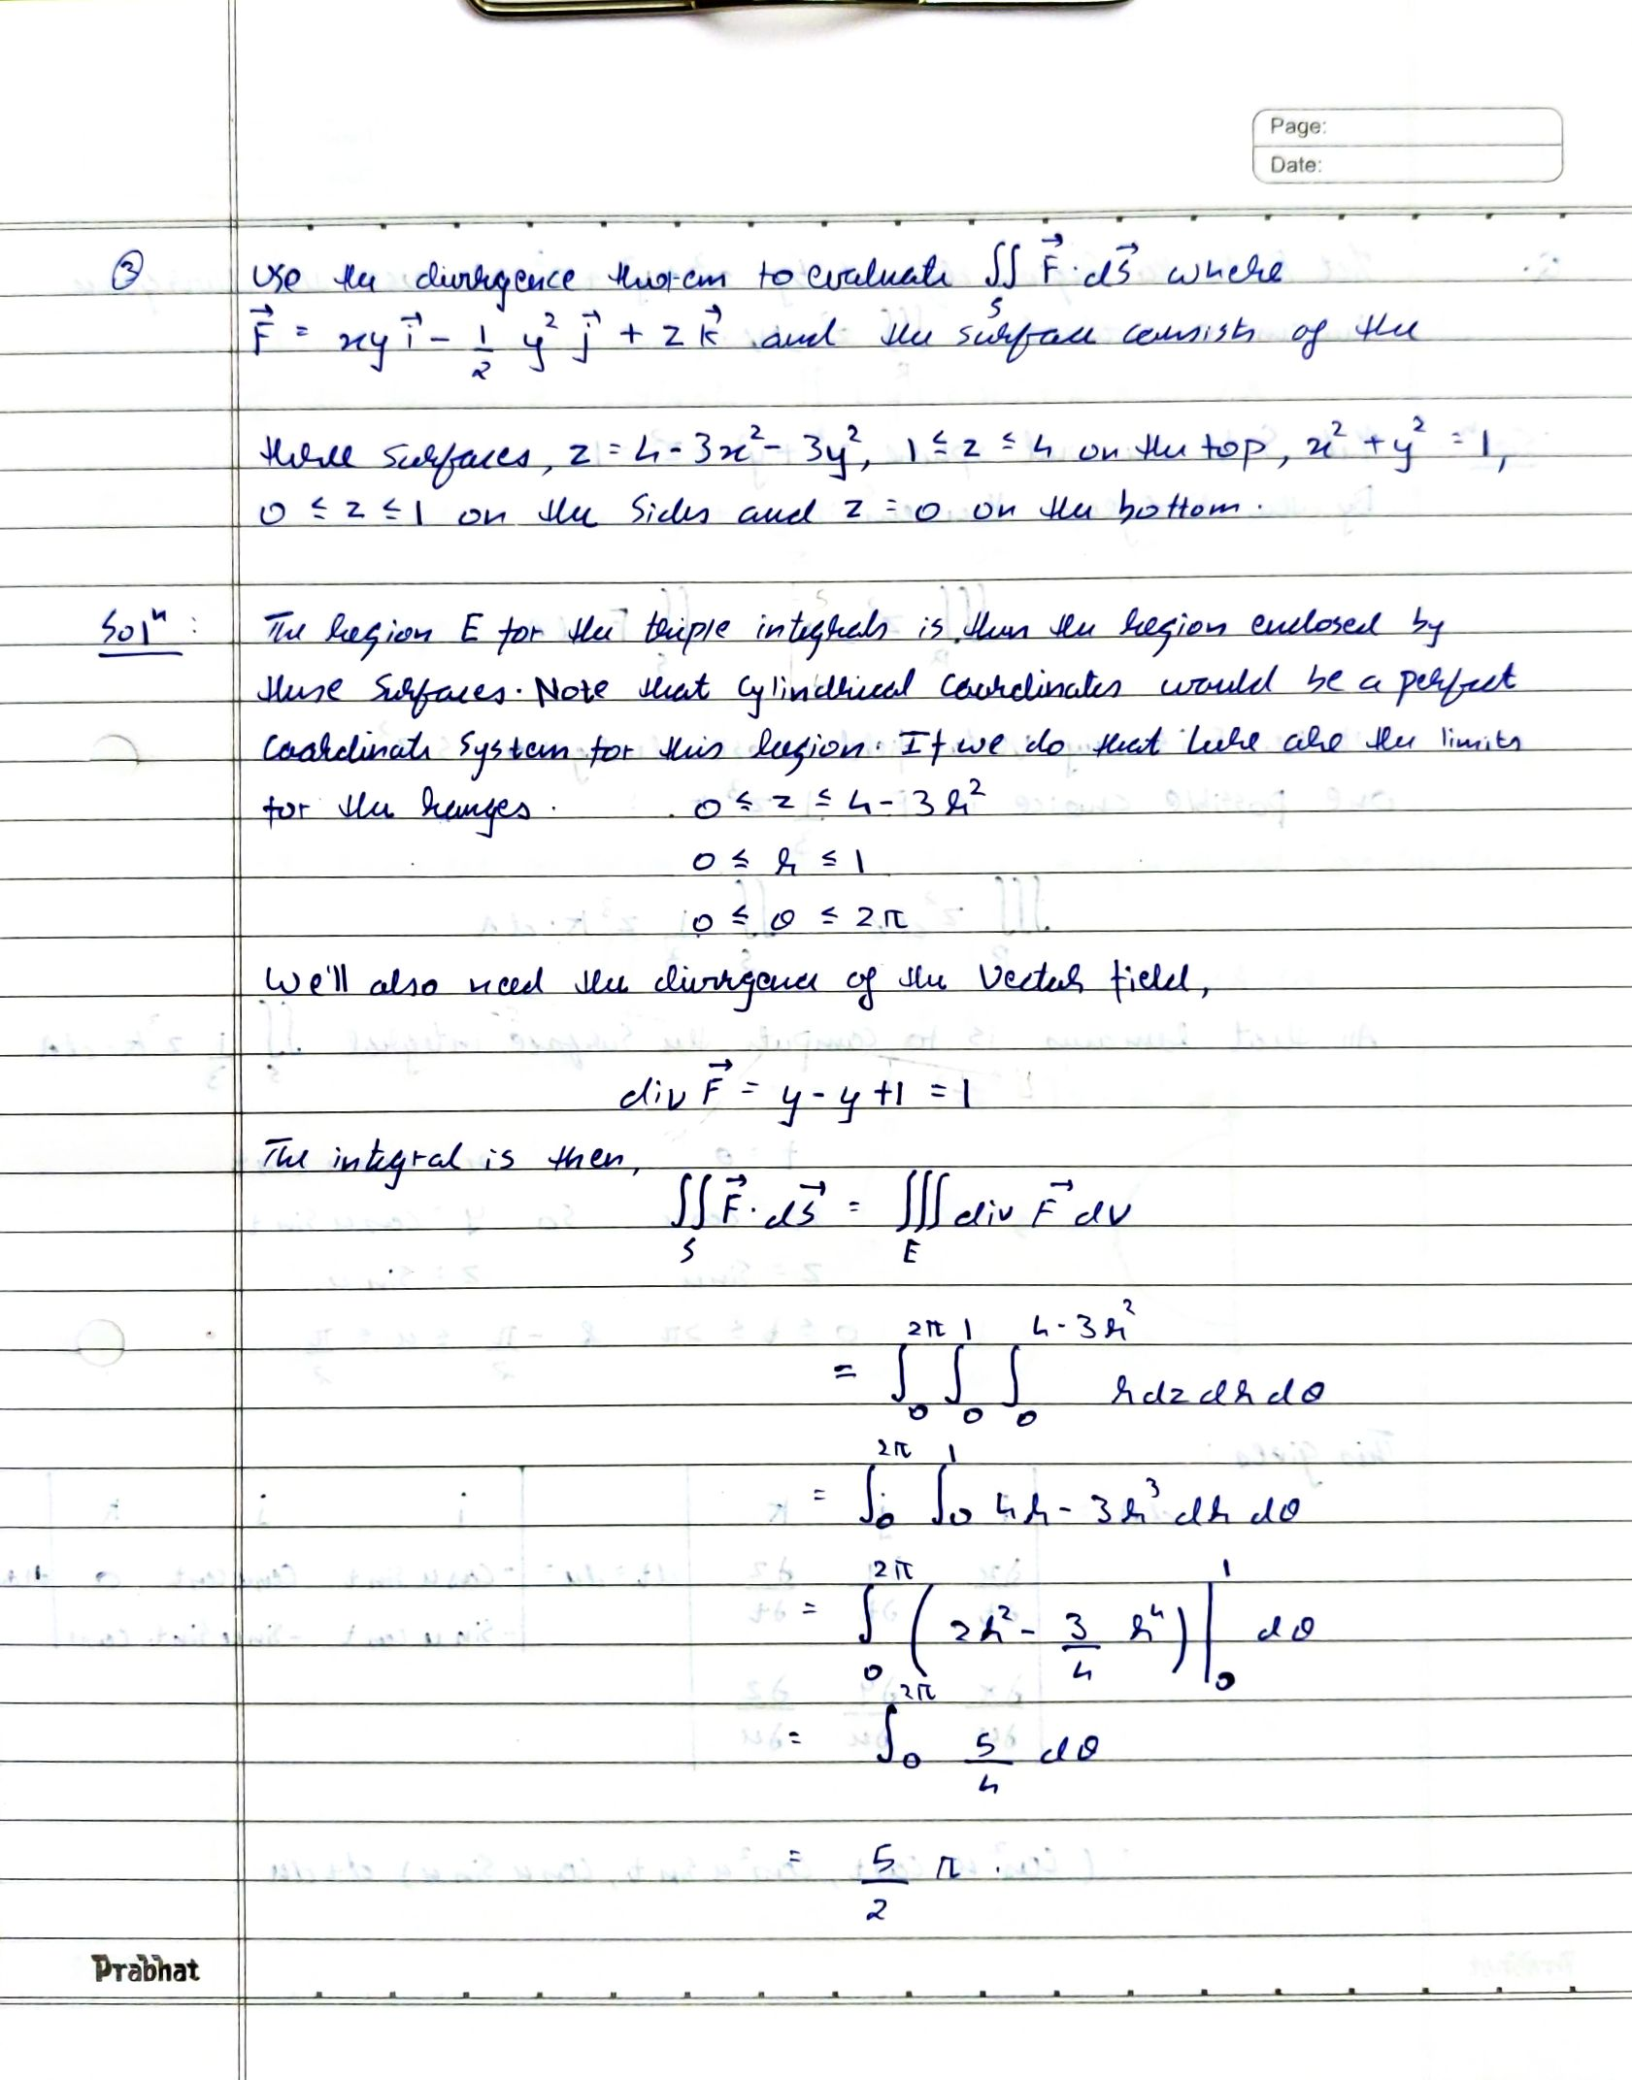
3)

Slide 20
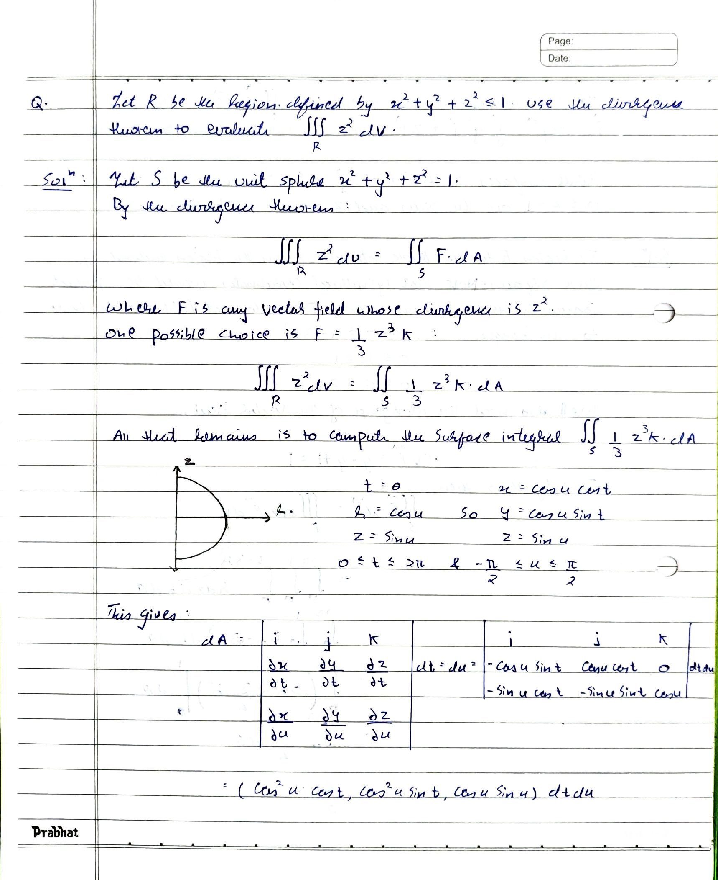
4)

Slide 21
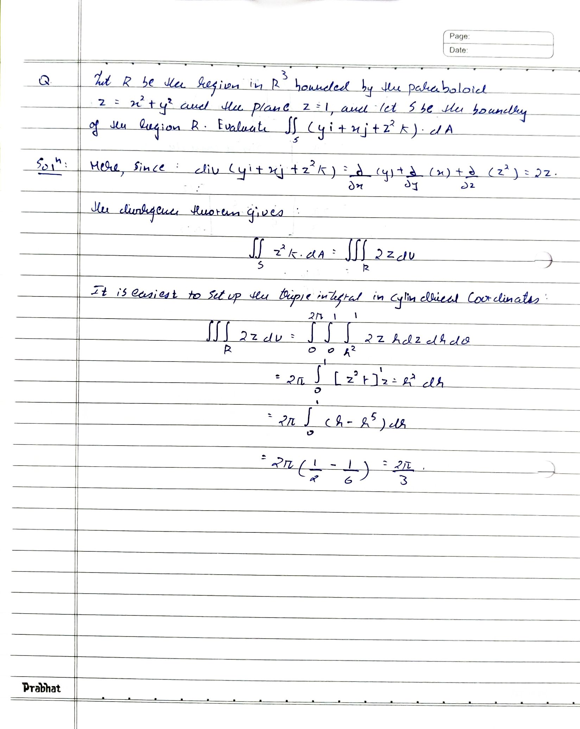
5)

Slide 22
APPLICATION:
In topographical map
Broadcasting of radio and TV programs
Fluid flow - from pipelines to jet engines.
In physics for application of concepts like Columbs law,
Inverse square law of force and in superposition theroum

Slide 23
BIBLIOGRAPHY:

